Slide 1

LLM performance on tasks
4 local models
6 openrouter
minimax - expensive
nemotron - really fast and cheap and also good
gpt-oss - suprisingly slow

Slide 2
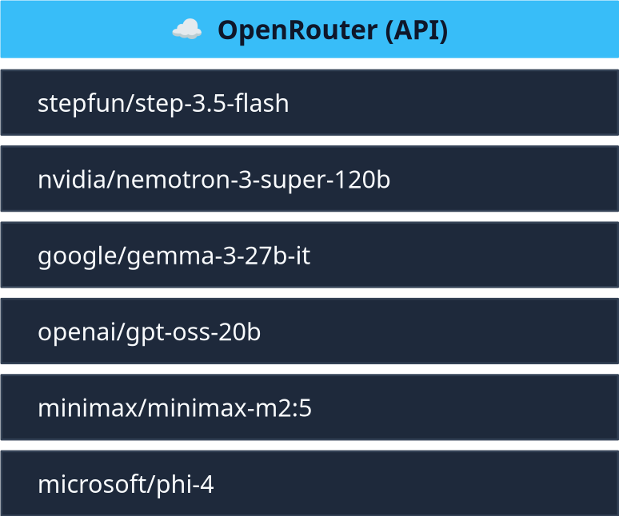
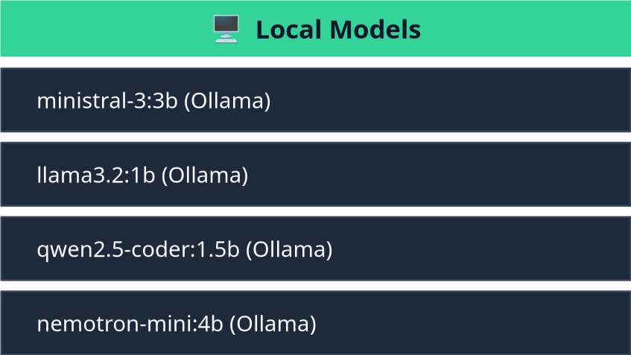
Open Router vs MIF HPC
Both fast, first took 0.025 cents to complete, second was free!

Slide 3
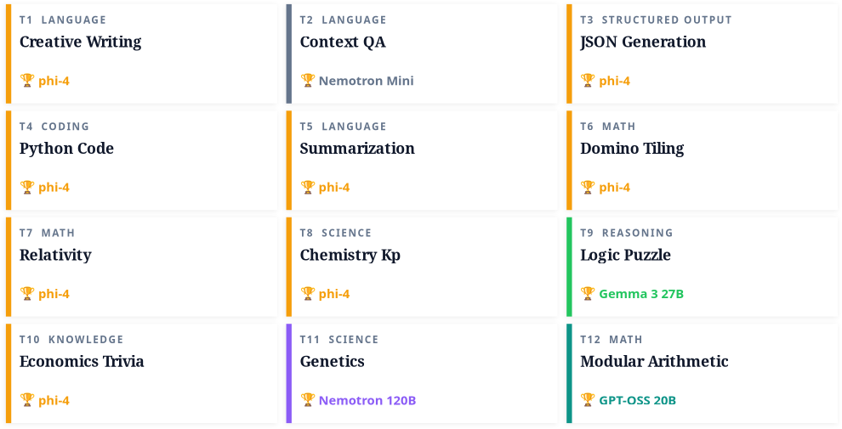
+- ofcourse most of time these models got score 10/10 according to DeepSeek but one had to be choosen to advance to the next level

Slide 4
Creative Writing
microsoft/phi-4
Was one of the faster ones with answer in just 2.6 seconds. Also nice output.

Slide 5
Context QA
nemotron-mini:4b
Really fast answer in just 0.3 seconds. The model was ran on HPC.

Slide 6
JSON generation
ministral-3:3
minimax/minimax-m2:5
The fastest one locally (1.7 seconds) but to be honest most of the models completed this one successfully
Failed, did not complete the JSON generation fully

Slide 7
Python Code
ministral-3:3b
qwen2.5-coder:1.5b
Local, implemented the function in just 2.7 seconds, provided a good example.
Just as good, output in 2.2 seconds.
OpenRoutere models performed also just as well, but slower

Slide 8
Summarization
nemotron-mini:4b
qwen2.5-coder:1.5b
Really fast, just 1 second to sumup it pretty well
Even faster, 0.7 seconds, which makes sense since this model was specifically made for autocompletion
Some models added extra text not present in the original one, hence their scores were reduced. Overall, local models were really good at this.

Slide 9
Domino tiling
openai/gpt-oss-20b
local models failed
Fastest answer in 0.24 seconds, second place goes to microsoft/phi-4
for just as fast answer in 0.3 seconds.
All local models failed, though by iterating this question on nemotron-mini:4b a few times, sometimes you can get it to answer correctly

Slide 10
Relativity
nvidia/nemotron-3-super-120b-a12b
local models failed
It seems like these local models are too small for thesse difficult questions
The fastest model, answered in 1.43 seconds.

Slide 11
Chemistry kp
stepfun/step-3.5-flash
local models failed
Did not try to answer this question.
It seems like these local models are too small for thesse difficult questions
This test highlights the differences between models just trying to output a number and models that diregard the test saying to output only one number and actually do some steps for calculations. These models seem to produce better output.
microsoft/phi-4
Answered fastest in 6.24 seconds, also did not forget to provide units

Slide 12
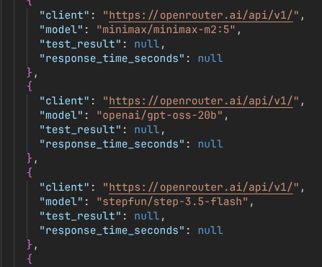
Logic puzzle
The difficult question: multiple failures???
Local models return
llama3.2:1b, ministral-3:3b
returning answers in 2.56 and 2.7 seconds.
microsoft/phi-4
Answers correctly in 9.14 seconds, though in lengthy explanation
google/gemma-3-27b-it
Gives answer in almost 30 seconds,
also lengthy answer, has a table

Slide 13
Economics trivia
google/gemma-3-27b-it
qwen2.5-coder:1.5b
Answered in 0.75 seconds
Answered in 0.2 seconds, with variation.
All models except llama3.2:1b answered this one correctly

Slide 14
Genetics
ministral-3:3b
nvidia/nemotron-3-super-120b-a12b
The only one local model that did not fail
Answered fastest in 1.67 seconds.
All OpenRouter models finished this test successfully

Slide 15
modular arithmetic
openai/gpt-oss-20b
Local models failed
Answered the fastest in 3.80 seconds

Slide 16
Sumup
microsoft/phi-4
ministral-3:3b
Good for most tasks, is quite quick and precise
Works reliably, answers fast
openai/gpt-oss-20b
qwen2.5-coder:1.5b
Just as good as phi-4, though a little slower sometimes, also the API can freeze sometimes.
Really fast generation as it was made for autocompletion
nemotron-mini:4b
Good balance between speed and precision

Slide 17
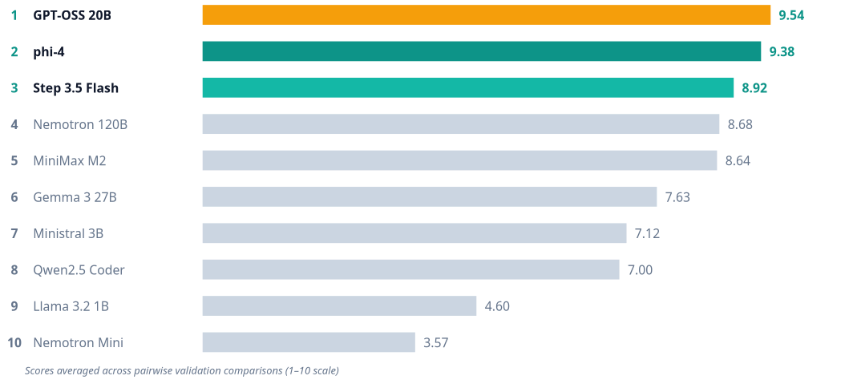
By Claude so keep in mind it might have messed up math

